Slide 1
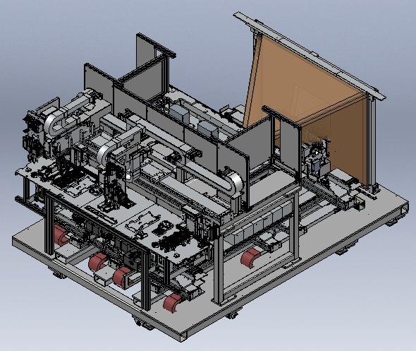
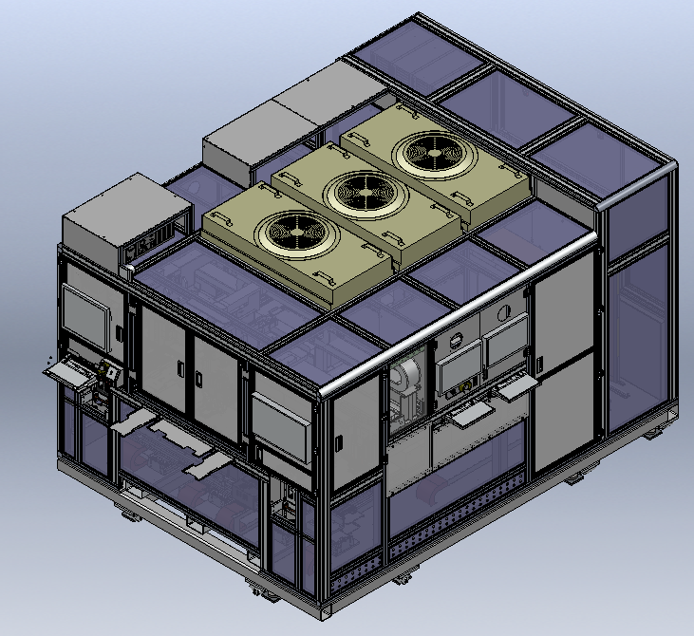
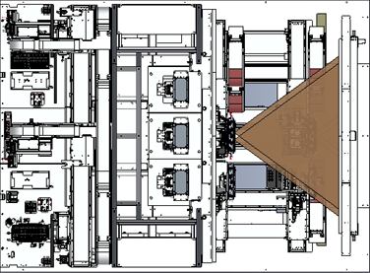
2. LAY-OUT & Process Flow ( 3 Rail Built in Handler )
Machine Size : 3200(L) x 2,350(D) x 2,100(H)
Chart
LPFF / P2P Tube
Loading Arm
Quad Socket
( 3 Rail )
Unloading Arm
Ambient Light
( IR Reflector )
Input Tray
( Input Port )
H
Dark Box
Drawer
( 2x, Tray Stacker )
Output Tray
( Output Port )
L
D
8
1
2
Pick from
Input tray
Place to
Socket
Loading Arm
7
6
3
4
5
6
3
4
5
Dark
LPFF
Depth
P2P
2
Each Rail Stage
7
8
Pick from Quad socket
Transfer to Output tray
Unloading Arm
1
2 / 14

Slide 2
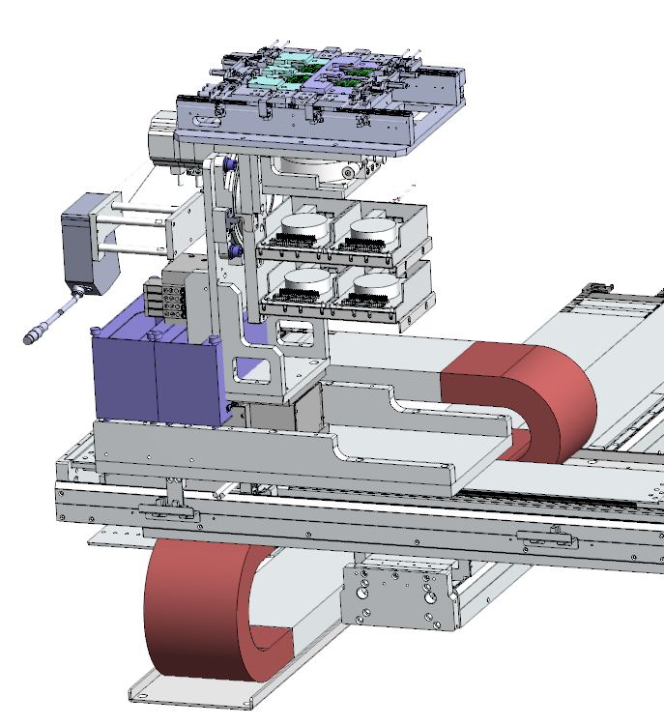
3. Tester Unit Detail
3.1 Rail Stage
Transferring quad socket to each test zone
Role
Unit Overview
Spec.
Item | Specification
Socket | Quad Socket with 4 single channel grabbers and 2 dual TEC controllers
Grabber | HVS Canyon3J
Transfer | 2 Linear Axis with Linear motor ( X, Y )
 | 2 Linear Axis with Stepping motor ( Z, Tx )
Displacement Sensor | Optional, For the maintenance
Remark | The Quad socket is customized for product design by PRI
Quad Socket
Tx Axis
( Stepping )
4x Single Grabber
Y Axis ( Linear )
2x Dual TEC Controller
Z Axis ( Stepping )
X Axis ( Linear )
3 / 14

Slide 3
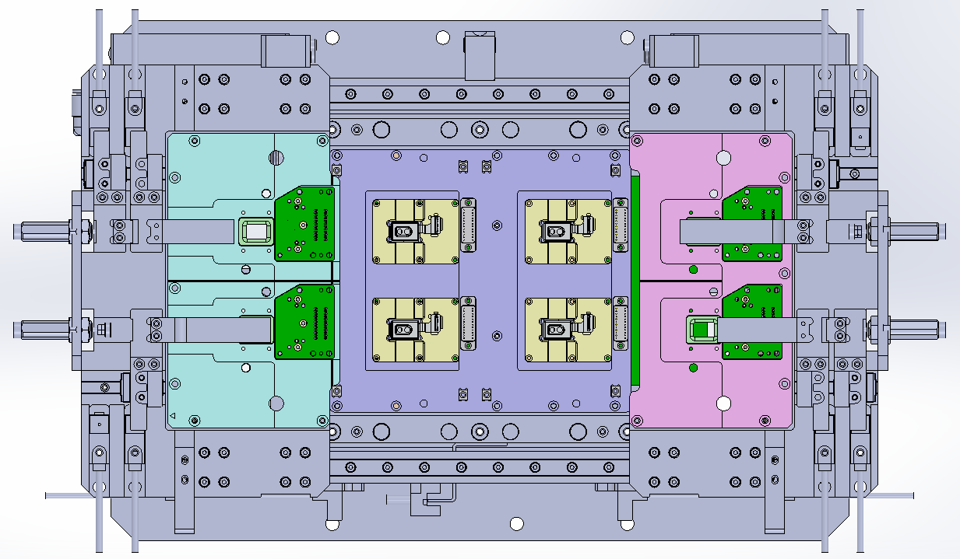
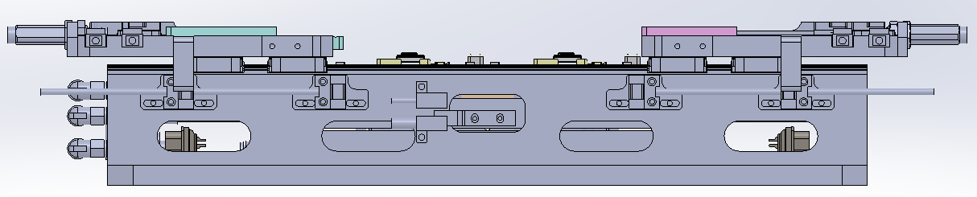
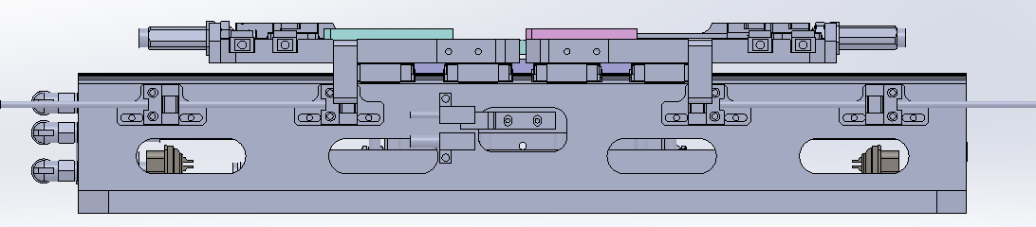
3. Tester Unit Detail
3.2 Quad Socket ( Rail Stage )
Component for the depth calibration zone
Role
Unit Overview
Spec.
Item | Specification
Socket Type | Quad Socket ( 4 Modules )
Module Pitch ( mm ) | 62 x 40
Module Tilting in the Socket ( ° ) | ± 0.05
Grabber | Has 4 x HVS Canyon 3 grabber ( Single CH )
Temperature | Has Individual TEC Controller ( 2 CH x 2 set )
TEC Force ( N ) | Maximum 5N
Remark | Has Individual shutter for each socket Socket should be has low reflectance
40 mm
379 mm
62 mm
Top Plate 1 Stroke 60 mm
Top Plate 2 Stroke 60 mm
< Socket Open >
Socket Open/Close Sequence
1 . Top Plate Moving
2 . Socket Up
< Socket Close >
Socket Up/Down Stroke : 6 mm
4 / 14

Slide 4
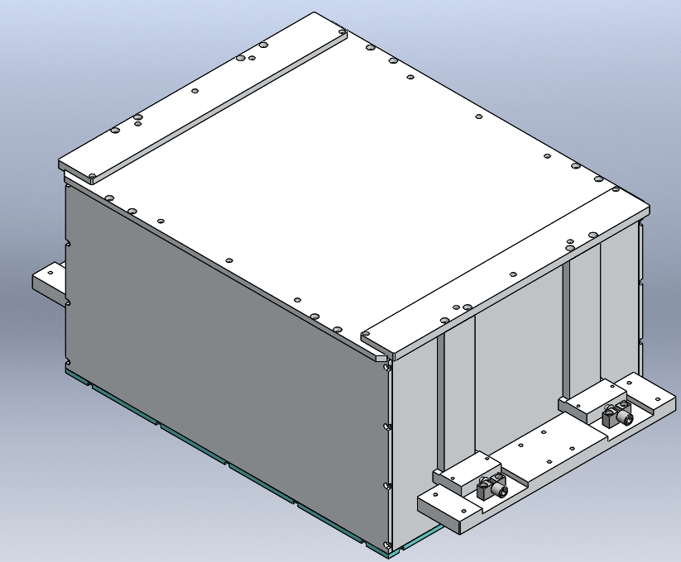
3. Tester Unit Detail
3.3 Dark Box ( Dark )
Component for the dark calibration zone
Role
Unit Overview
Spec.
Item | Specification
Coating Planarity (um) | 150
Reflectance( % ) | Top : 10 ( Typical : 10 ± 2 )
 | Side : less than 5
Box Size ( mm ) | 430 x 550 x 300
Remark | Dark box design is ACE approved Coating material should be confirmed by ACE
550 mm
430 mm
300 mm
5 / 14

Slide 5
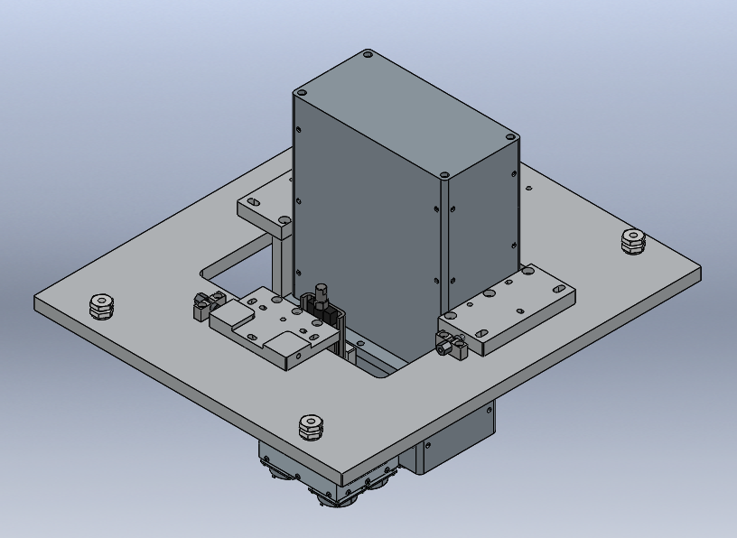
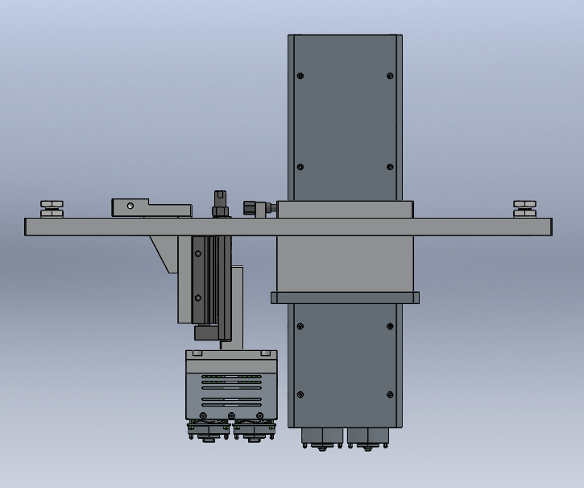
3. Tester Unit Detail
3.4 P2P & LPFF Tube ( P2P & LPFF )
Component for the P2P and LPFF calibration zone
Role
Unit Overview
Spec.
Item | Specification
Diffuser Count | Current : 2 P2P & 2 LPFF → To be : Will be applied Separated Quad P2P and Quad LPFF
Remark | Tester team released Quad P2P ERS And PRI submit P2P design proposal
P2P
LPFF
6 / 14

Slide 6
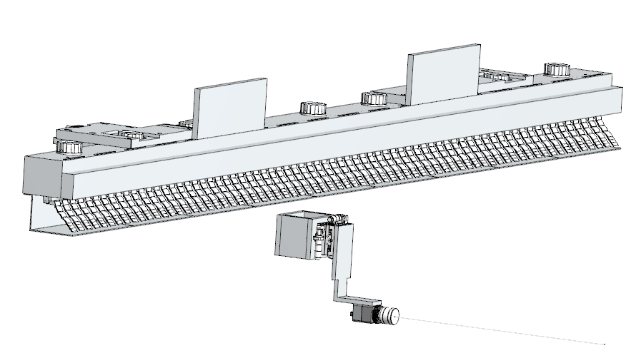
3. Tester Unit Detail
3.5 Ambient Light ( Depth )
Component for the depth calibration zone
Role
Unit Overview
Spec.
Item | Specification
Lighting Area ( mm ) | 1600 x 1210
Uniformity ( % ) | Min : 85, Typical : 90
IR LED | OSRAM SFH 4725AS ( 72 EA LED used )
Ambient Light (W/m^2) | 10 ~ 15 ( Typical : 12 )
Remark | IR LED specified by ACE
Ambient Light
( IR Reflector )
IR Vision
( IR reflector uniformity monitoring )
7 / 14

Slide 7
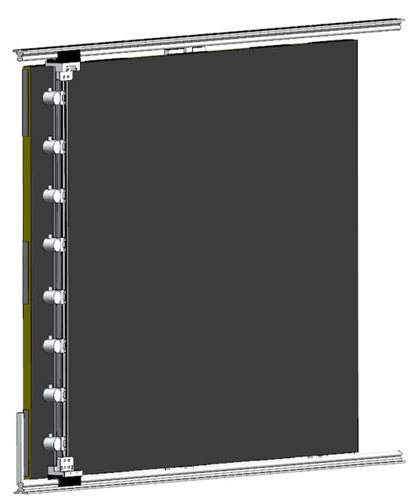
3. Tester Unit Detail
3.6 Chart ( Depth )
Component for the depth calibration zone
Role
Unit Overview
Spec.
Item | Specification
Chart Size ( mm ) | 1590 x 1180 ( Square size : 63 )
Chart surface Flatness ( mm ) | ± 0.25
Reflectance ( % ) | Chart : 10
 | Square : 20
Remark | Apple approved chart : JOT STA- 1964 IR reflector uniformity is setting by 8 set irradiance meter ( lied on manual stage )
X Axis ( Manual )
8 set Irradiance meter
( IR reflector uniformity setting )
Chart : JOT STA - 1964
8 / 14

Slide 8
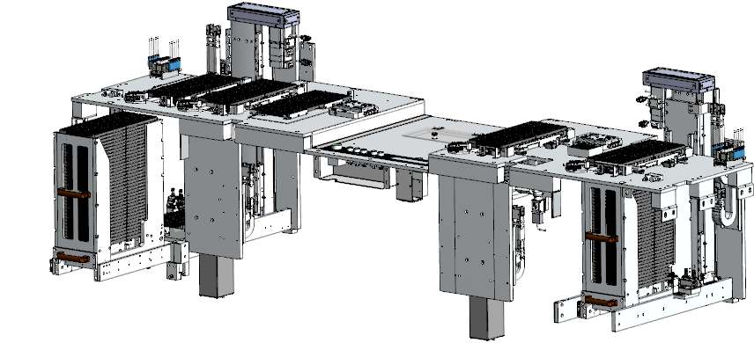
4. Handler Unit Detail
4.1 Drawer
Handle a stacked tray
Role
Unit Overview
Spec.
Item | Specification
Drawer Count | Total : 2 Set ( Input, Empty)
Drawer Capability | 20 Trays for Input and OK 2 Trays for Empty and NG 1 Tray for CTS
Transfer | Tray Up/Down : 1 Servo Cylinder
 | Drawer Forward/Backward : 1 Manual
Maximum Tray In/Out Count | 20 EA
Tray Align | Four side walls guided stacked trays moving
Remark
CTS
( 1 Tray, Manual )
OK
Empty
NG
( 5 Tray, Manual )
Side walls
Input
Drawer Forward/Backward
Servo Motor ( Tray Up/Down )
9 / 14

Slide 9
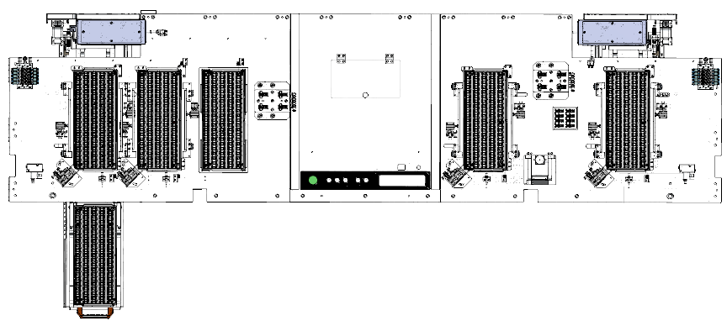
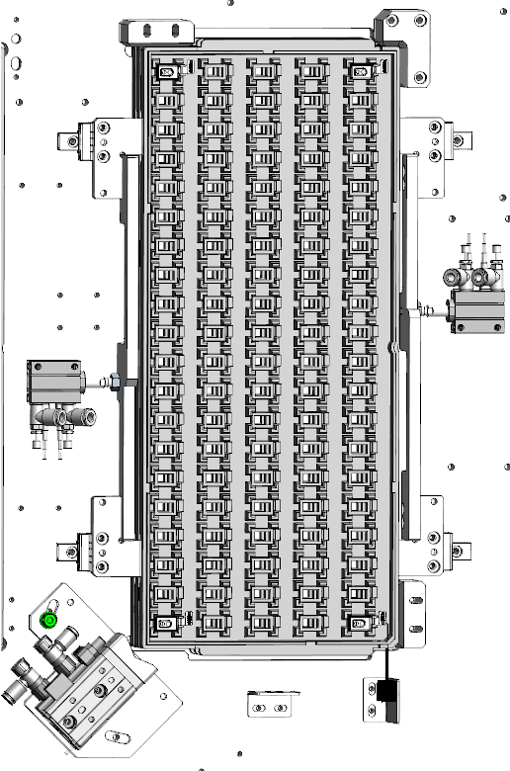
4. Handler Unit Detail
4.2 Input / Output Tray Port
Support and Align a input / output tray
Role
Unit Overview
Spec.
OK
Input
Item | Specification
Port Count | Total : 5 ( Input, Empty, CTS, NG, OK )
Tray support | Has 2 tray support cylinder ( Each cylinder has 2 tray supporting guide )
Tray Align | Align cylinder
Remark | Can placed on a golden module tray for the Audit module
Empty
NG
CTS
Golden
( Audit )
Align base line
Tray Supporting Cylinder
: Prevent falling a tray
( 4 supporting guide )
Align Cylinder
: Align cylinder is move forward
→ Tray will be aligned to the align
base line ( Right –Top )
Tray Detection Sensor
10 / 14

Slide 10
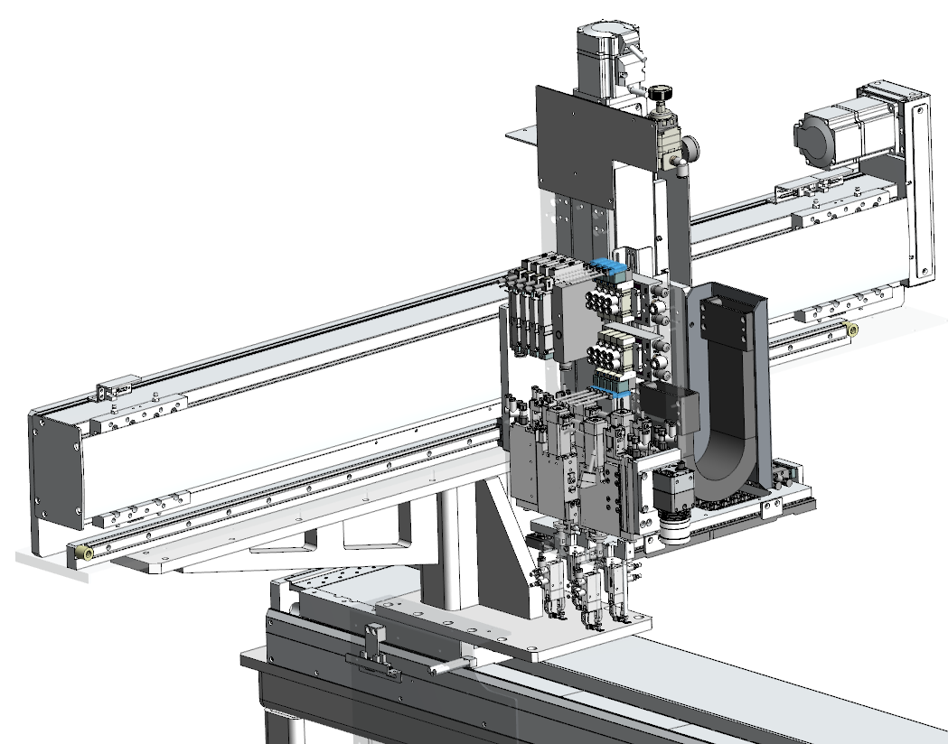
4. Handler Unit Detail
4.3 Loading Arm
Transferring 4 DUTs from a input tray to the tester socket
Role
Unit Overview
Spec.
Item | Specification
Tray Picker | Has 2 clamp cylinders
Module Picker | Has 4 module picker fingers Each finger has 2 clamps for DUT CAN and 1 Vacuum Pad for DUT flex
Transfer | 2 Linear Axis with Servo motor ( Y, Z )
 | 1 Linear Axis with Linear motor ( X )
 | 4 Rotation Axis with Stepping motor ( Finger Rotation )
Remark | Has the top vision camera for a BCR reading and socket loading position check
Z Axis ( Servo )
4x Finger Rotation
Top vision camera
Y Axis ( Servo )
X Axis ( Linear )
11 / 14

Slide 11
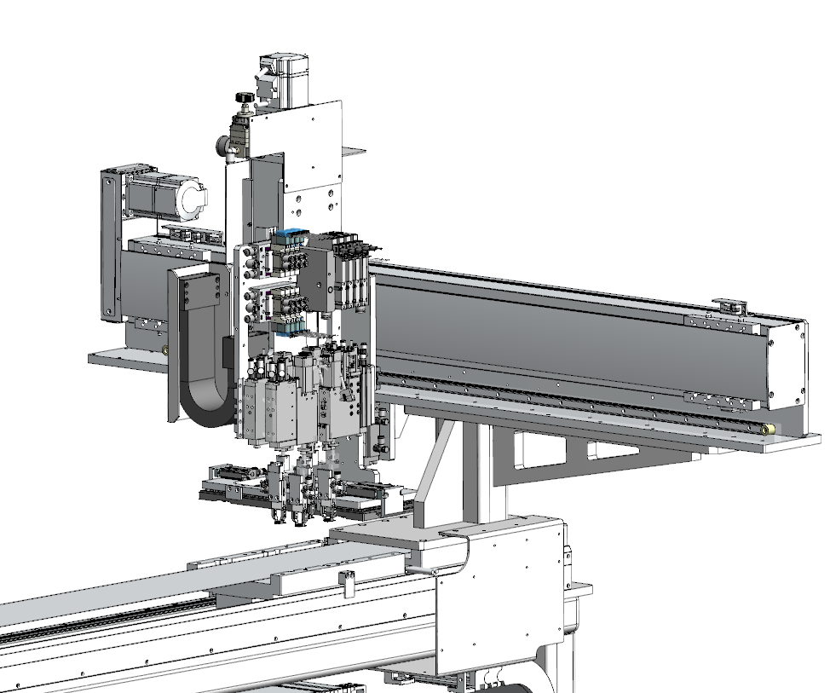
4. Handler Unit Detail
4.4 Picker ( Loading and Unloading Arm )
Transferring 4 DUTs from the tester socket to a output tray
Role
Unit Overview
Spec.
Item | Specification
Tray Picker | Has 2 clamp cylinders
Module Picker | Has 4 module picker fingers Each finger has 2 clamps for DUT CAN and 1 Vacuum Pad for DUT flex
Transfer | 2 Linear Axis with Servo motor ( Y, Z )
 | 1 Linear Axis with Linear motor ( X )
 | 4 Rotation Axis with Stepping motor ( Finger Rotation )
Remark
Z Axis ( Servo )
4x Finger Rotation
Y Axis ( Servo )
X Axis ( Linear )
12 / 14

Slide 12
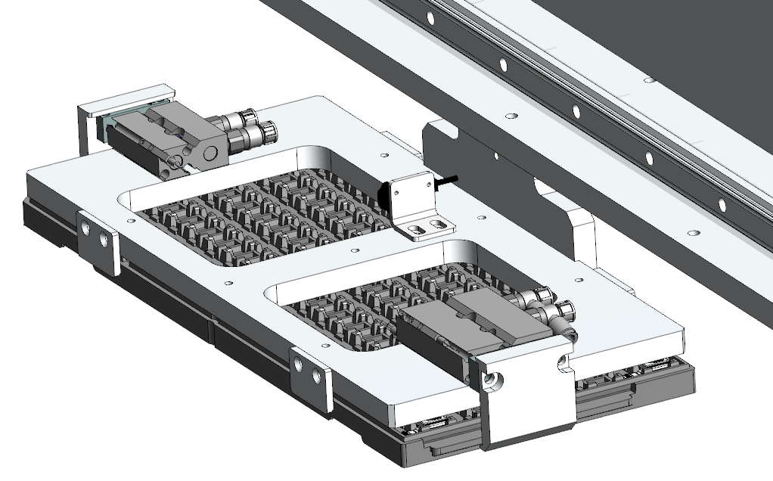
4. Handler Unit Detail
4.5 Tray Picker ( Loading and Unloading Arm )
Pick and place a empty tray
Role
Unit Overview
Spec.
Item | Specification
Tray Picker | Has 2 clamp cylinders
Remark | Tray picker handles a empty tray 1. Input port → Empty port 2. Empty port → Output port
Tray Guide Block
Tray Clamp Cylinder
13 / 14

Slide 13
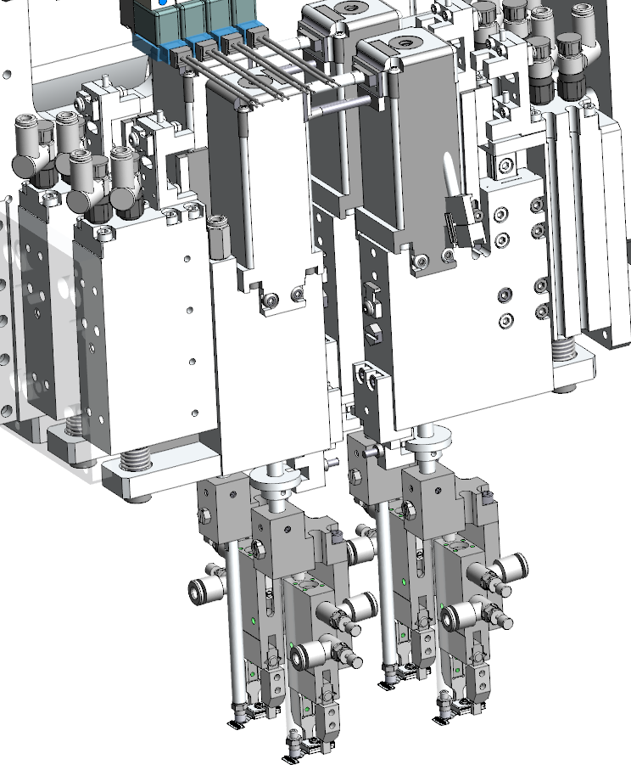
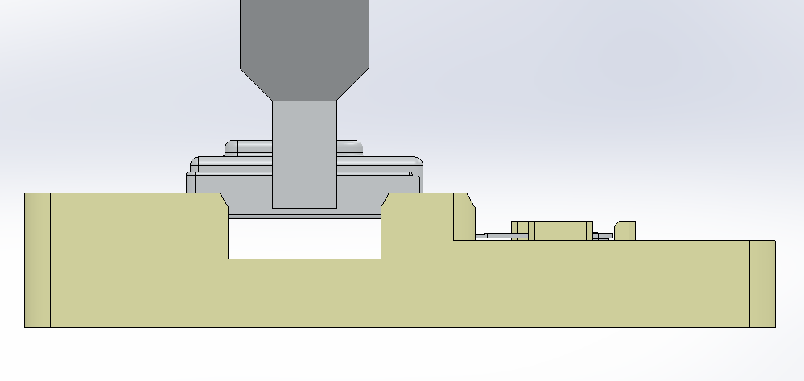
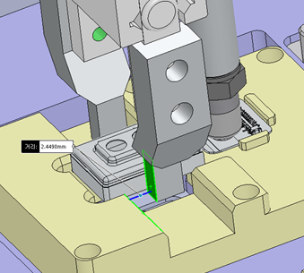
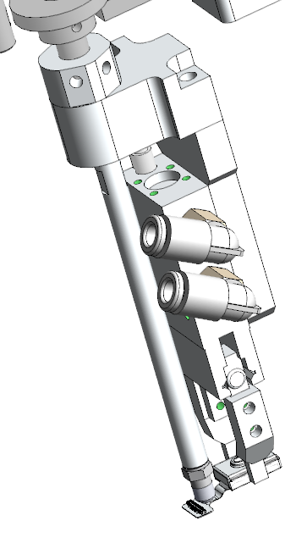
4. Handler Unit Detail
4.6 Module Picker ( Loading and Unloading Arm )
Pick and place 4 modules
Role
Unit Overview
Spec.
Item | Specification
Module Picker | Has 4 module picker fingers Each finger has 2 clamps for DUT CAN and 1 Vacuum Pad for DUT flex
Remark
4x Module Picker
Each Finger has rotation axis
Picker pad & Clamp
Picker Pad
Clamp
14 / 14

